Slide 1

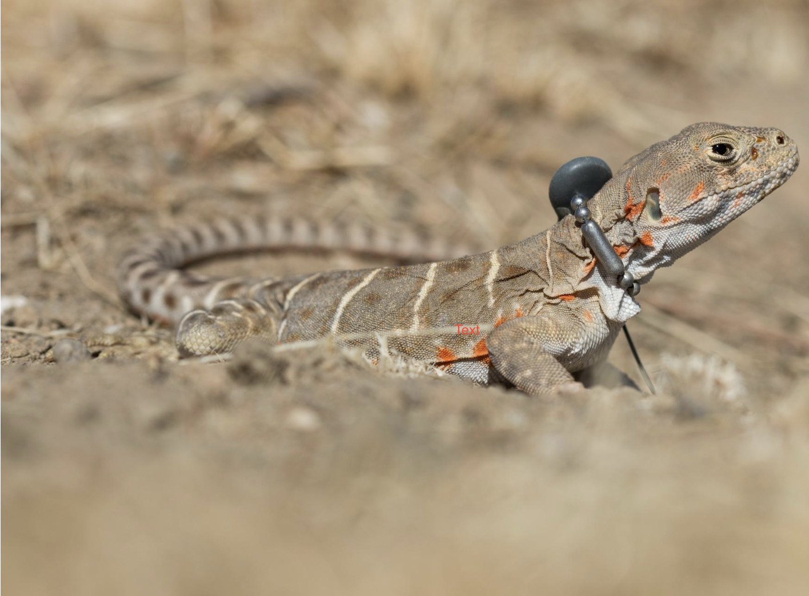
Lizard Localization Week 8 Project Update: June 02, 2023
Vinit Saah, Joey Schnecker,
Ryan Margraf, Hassan Ahmad
Project GitHub Link
https://github.com/joey-public/WES207CapstoneProject

Slide 2
Agenda
Lab Testing and Data Result on GPS synced B200 (Vinit)
APP design (Includes Networking updates) (Vinit)
DSP updates (Joey)
TDoA Calculation/Localization updates (Ryan)
Future Items (Hassan)
Git repository update (Joey)
Video update (Hassan)

Slide 3
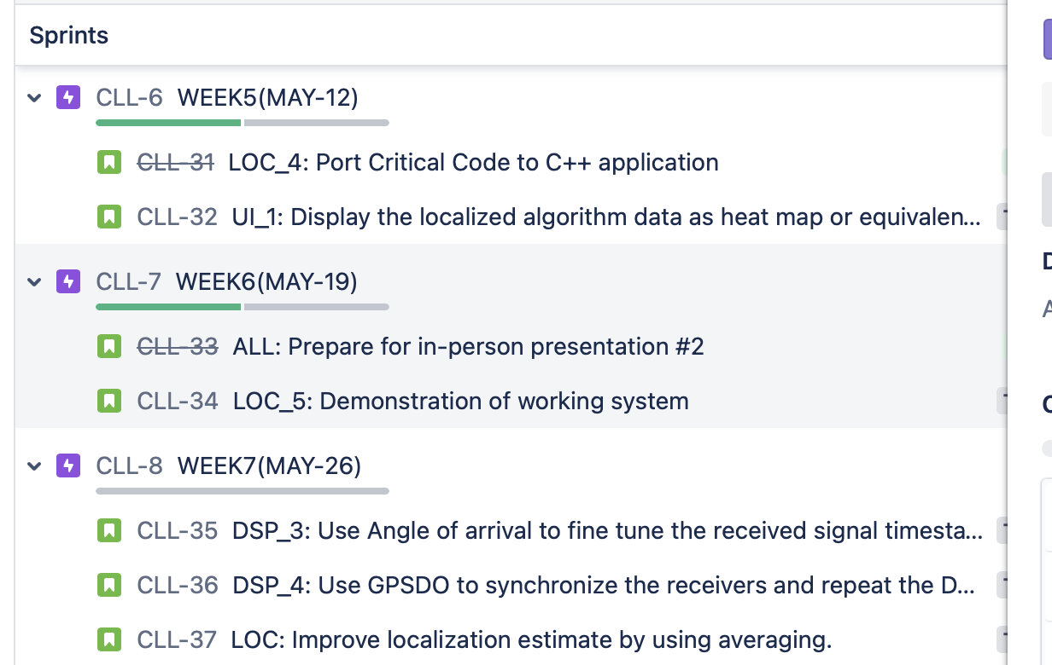
Overall JIRA updates

Slide 4
App design and Networking
System works end to end
Validated data flow
Host controller uses async write to broadcast commands to Host.
- Idea is to imitate non-blocking TCP write so that streaming and sync could start together
Host controller uses sequential Read command to retrieve data from all clients.
- Idea is to reduce complexity as large chunk of data would be shared between Host and Host controller.

Slide 5
App design and Networking
Command send to host are:
Config, sync,time stream, send.
Host: Takes corresponding actions of configuring USRP, Syncing to GPS timing, Streaming, Sending data
Synchronization verification:
Use ref_lock sensor to first reference lock.
Query for GPS Locked. Having GPS lock helps synchronize all USRP with same timings.
Query GPS Time, Last PPS time. In GPS synced state, last PPS = GPS Time.
Parse GPGGA, GPRMC messages to update longitude, latitude, altitude

Slide 6
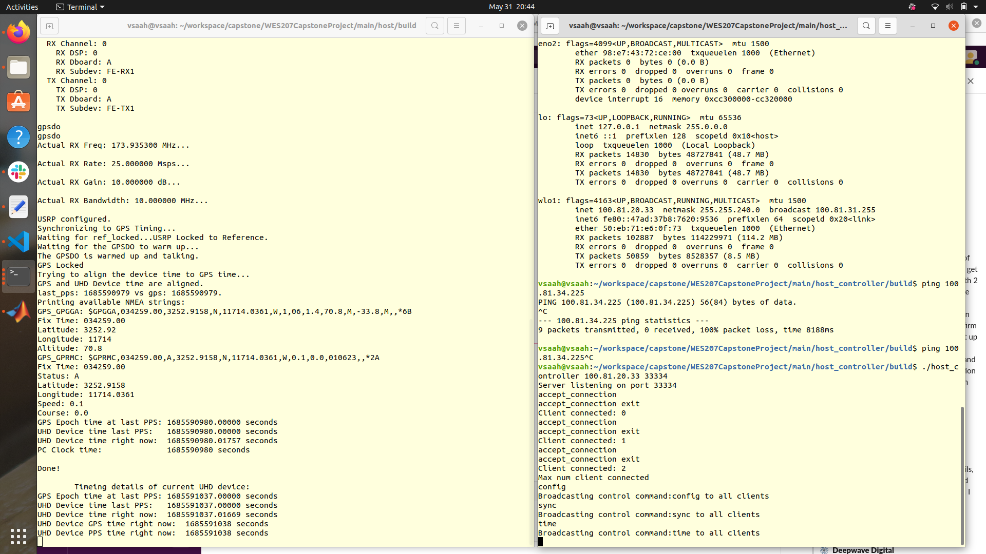
APP: Outputs
Host
Host -Controller
Configuration
GPS Synchronization

Slide 7
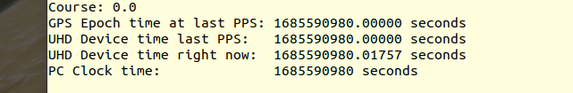
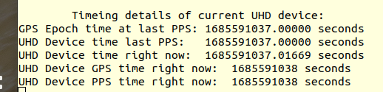
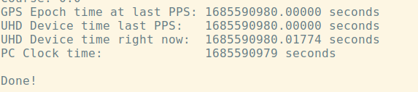
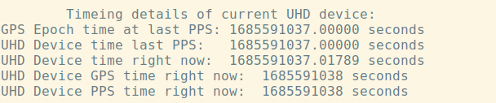
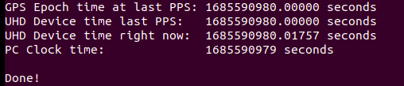
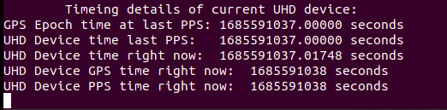
GPS time synchronization
Host A
Host B
Host C

Slide 8
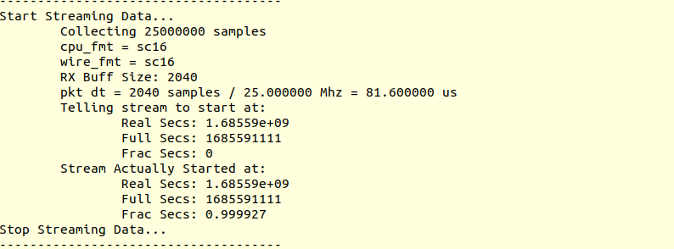
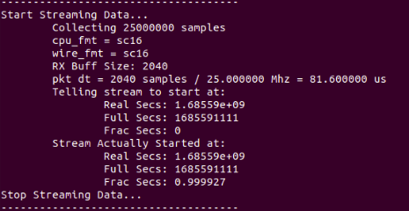
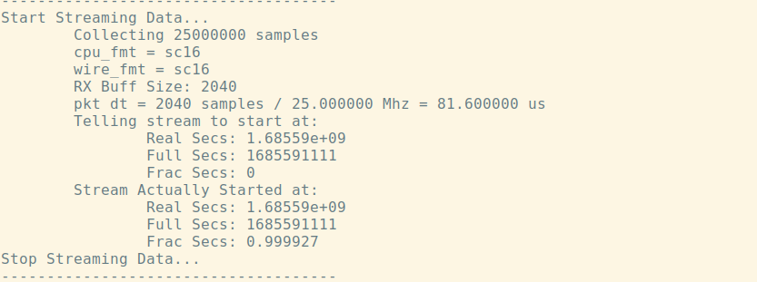
App stream synchronization
Host A
Host C
Host B

Slide 9
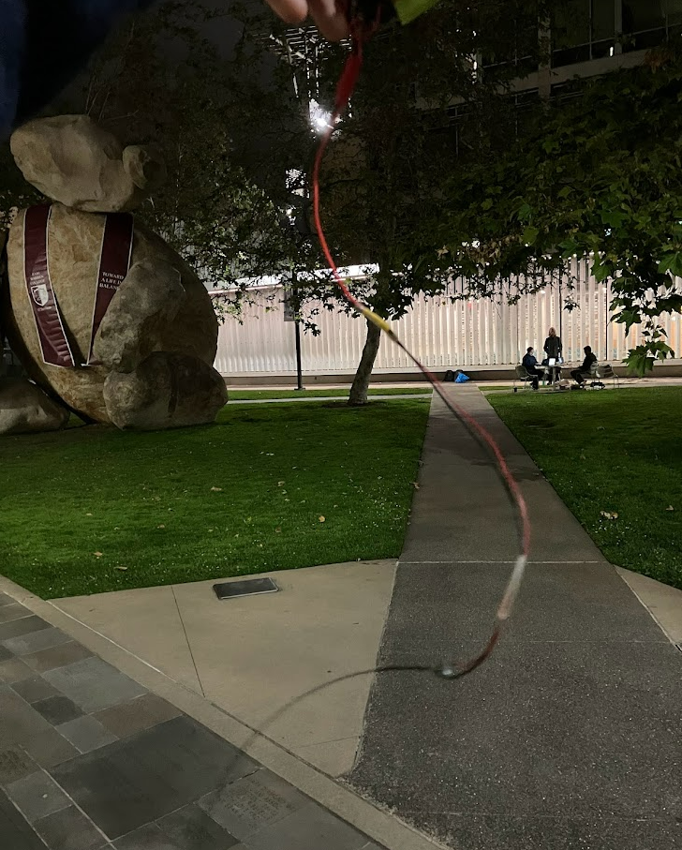
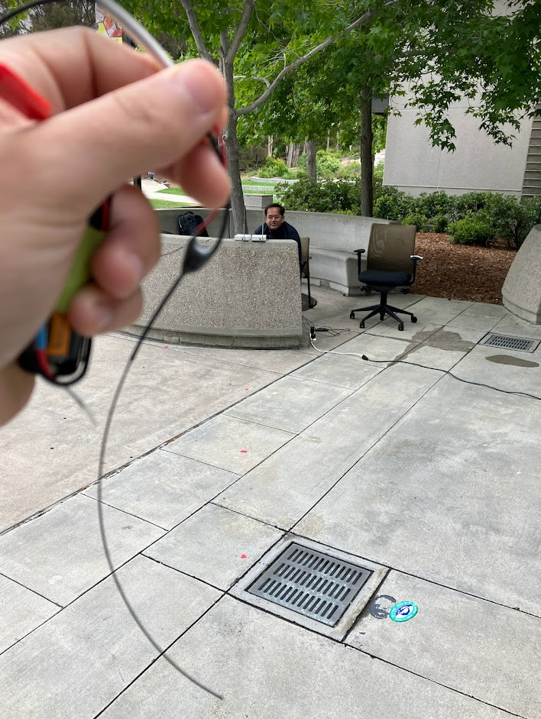
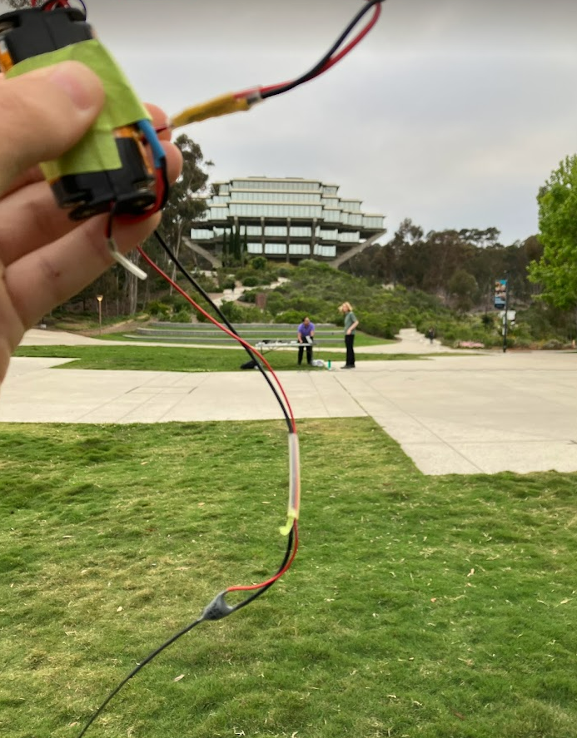
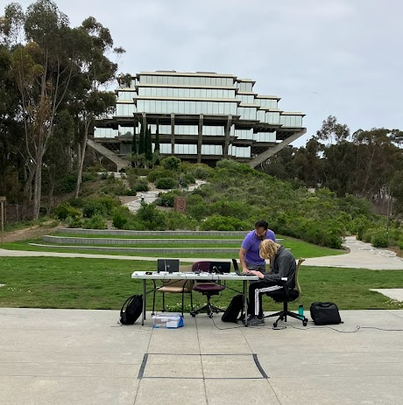
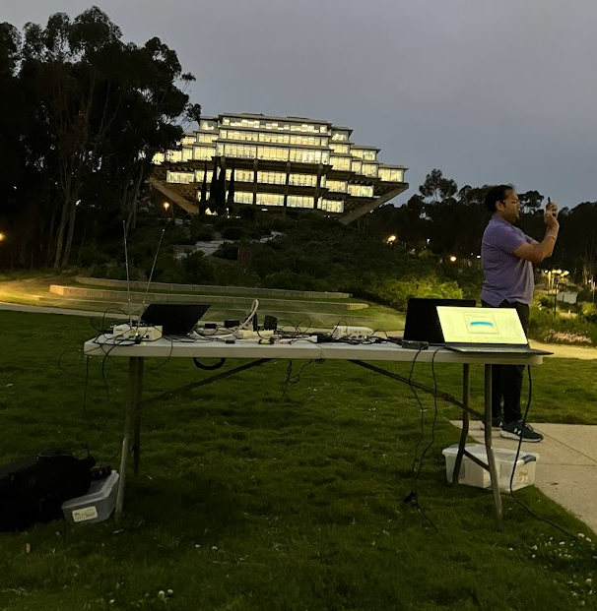
Testing

Slide 10
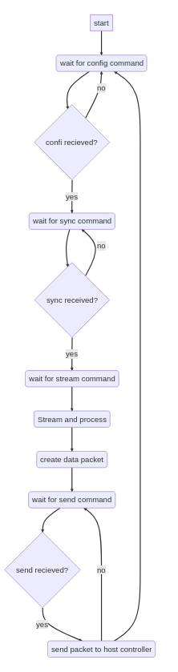
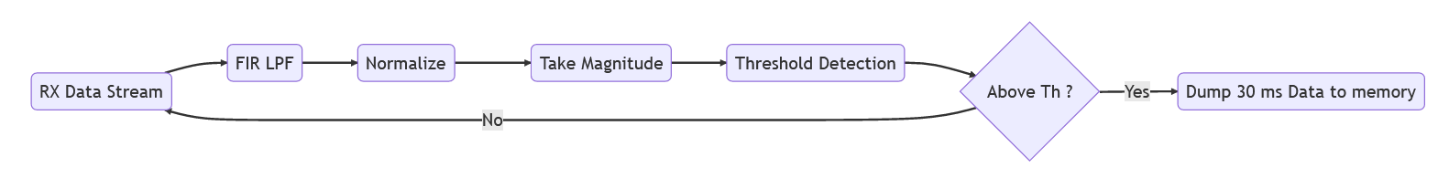
DSP Updates
Updated Streaming Code to Start Host Stream at an exact GPS time in the future
Only works thanks to B200s with GPSDOs
Updated Processing code to filter and normalize data before doing a threshold detection
Old Code simply looked for a peak in the raw data, but testing showed filtering was needed to separate the signal from the noise.
Updated to send 30ms of raw data that encapsulates the entire pulse
Simulations on raw data show that doing a cross correlation at the host controller side between the different received pulses produces improved TDOA estimations
RX_ID
RX_GPS_LOC
Time_Stamp
Raw_RX_Data_Stream

Slide 11
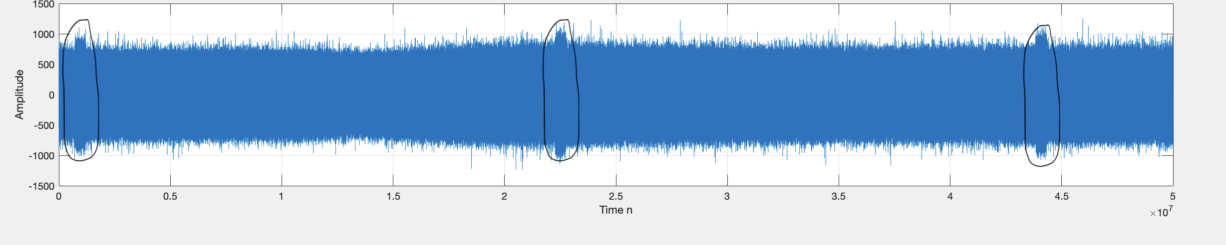
Testing Simple Threshold Detection
2 weeks before, naïve approach was a simple threshold detection on raw magnitude data
Major issue: Noise
Higher sampling rate introduces lots of noise. Sampling rate 25MS/s. Gain 20 dB, Tx at 10m.
When testing we were unable to detect pulses from more then a few meters (<5m) away.

Slide 12
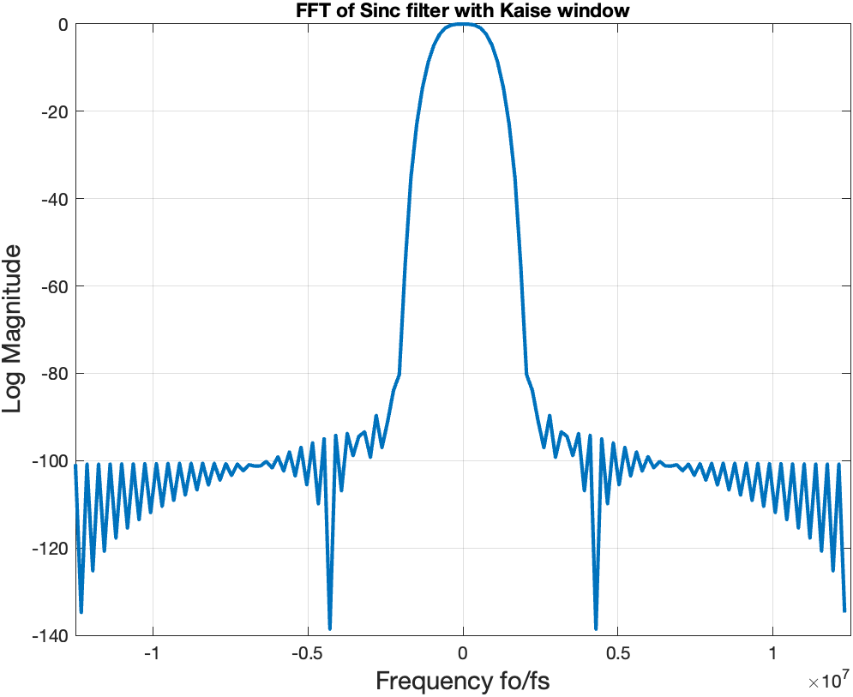
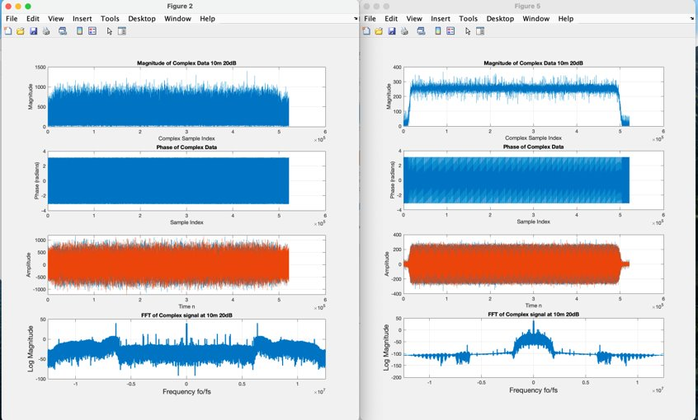
Simulation on May 27th Data:
Design Low pass filter
A) Designed Sinc filter with 67 taps, having Kaiser window for β =10 : Could detect pulse upto 20m
B) FIRPM with 32 Taps: Upto 10-15 metres.

Slide 13
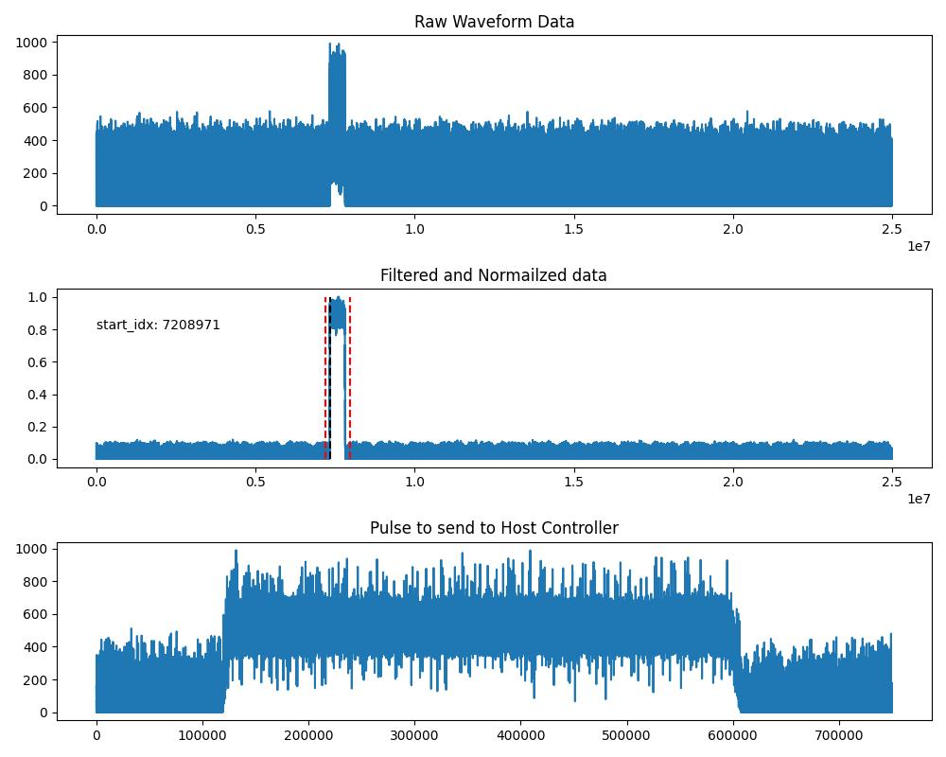
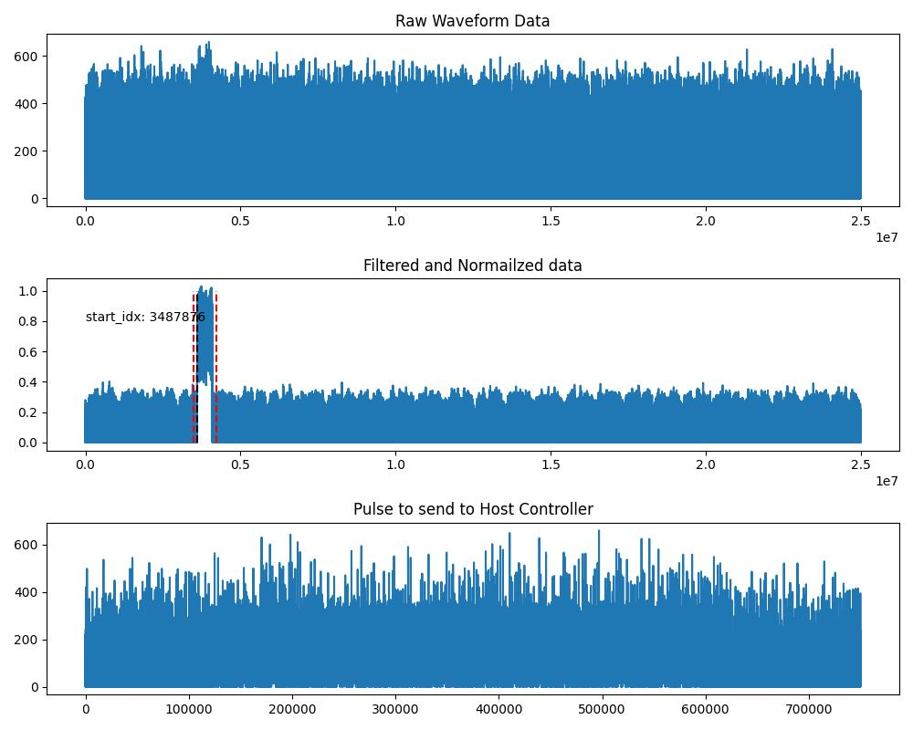
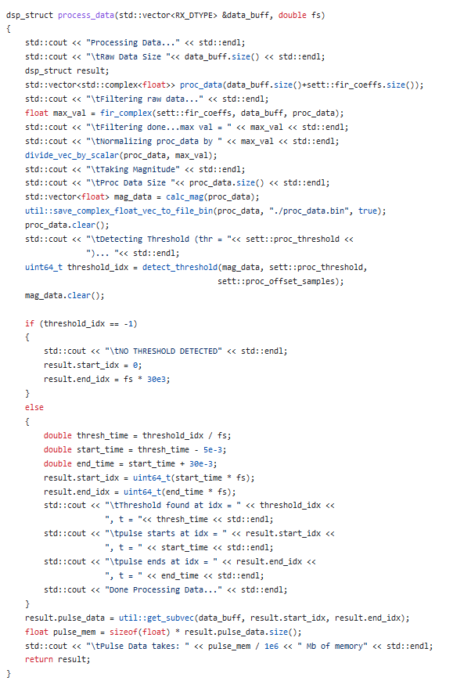
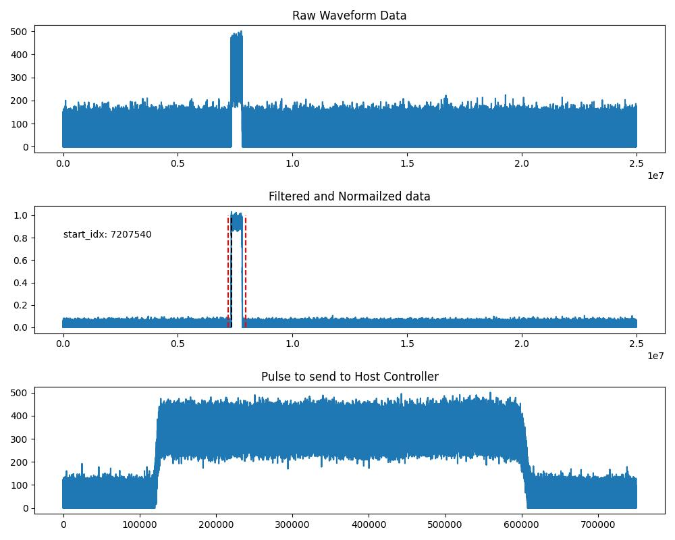
May 31st Testing New DSP
Example of Pulse Detection working from 20m
New Filtering approach increased pulse detection range from < 5m to about 20 meters.
Next Step is to send pulse start index from host to the host controller to be used in updated TDOA calculations.
Processing Source Code
Data From 2 Synchronized Receivers 10m from transmitter

Slide 14
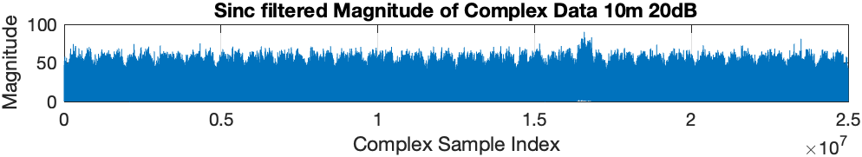
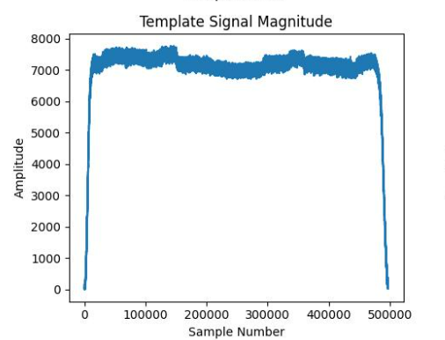
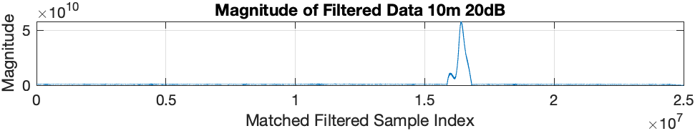
Possible Improvement
Another possible approach is to essentially use a matched filter by doing a cross correlation of the received data with a template pulse.
Simulation show this approach would increase the range of our pulse detection.
The above plots show simulation results for this technique
Simulation was performed on data collected on May 31st from a distance > 20 meters
Template signal is a raw data pulse we collected with the transmitter < 1m from the receiver (on May 27th)

Slide 15
TDoA Calculation/Localization
Threshold detection only provides an approximate ToA
To get more accuracy, cross correlation between the pulse data at each receiver is used to calculate a more precise sample index
Simulated in MATLAB, then ported to C++
Uses FFTW library
Next: Integrate into host controller flow

Slide 16
TDoA Calculation
Threshold Detection
Pulse Data (x4)
Cross Correlation
Sample Rate
Lags
TDoAs
Approximate Indices
—
Sample Differences
Hosts (4 receivers)
Host Controller

Slide 17
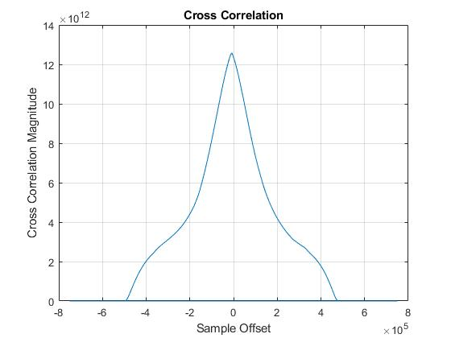
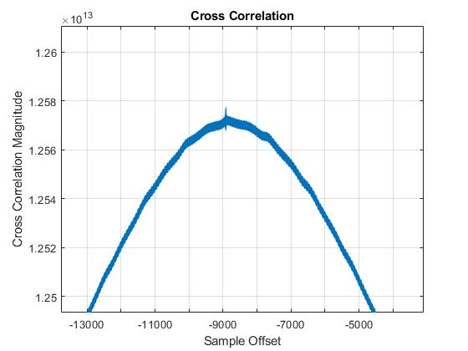
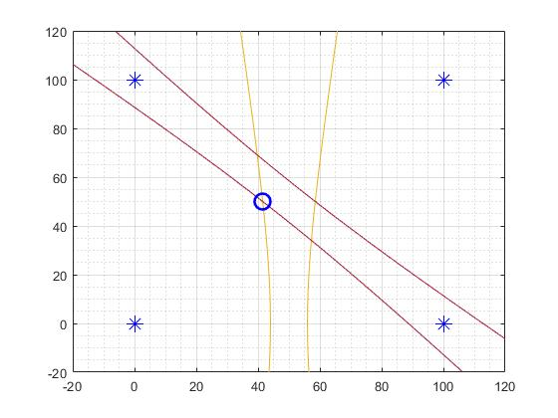
TDoA/Localization
Sample Difference in detection: -8913
Sample Difference in cross correlation: -8914
Corrected Sample difference: 1
Spec sheet of GPSDO says PPS is accurate to +/- 50ns (sigma)
25MHz sampling rate gives 40ns resolution
This demonstrates that synchronization and timing recovery is successful
Performed better on unfiltered data

Slide 18
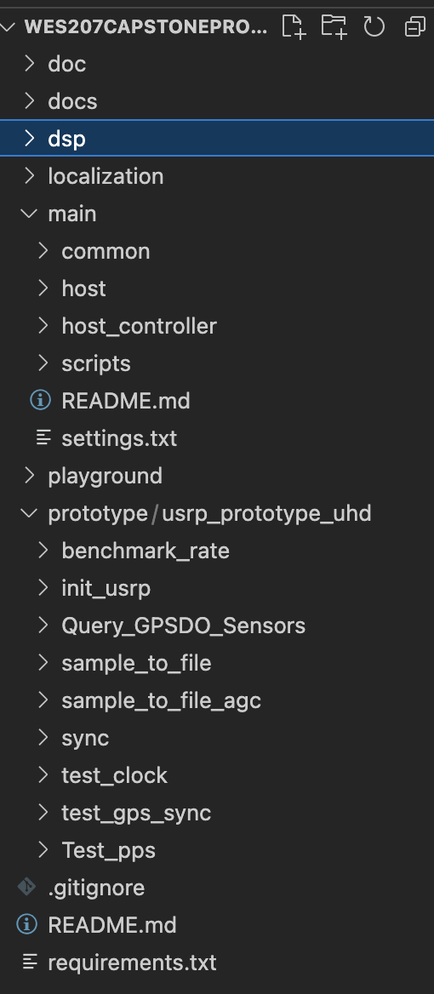
GitHub Repository
https://github.com/joey-public/WES207CapstoneProject
Key Takeaways:
-README included for all test apps, building repository, dependencies.
Host, Host controller APP code is in MAIN folder.
Prototyping code, DSP codes, are in respective folders with their README.
Plan to clean up excess files in folder structure, add appropriate documentation and Readme's by next week

Slide 19
Video Storyboarding
Discuss project need and motivation
Break down the problem tasks
Receiver Synchronization
Signal Receiving and Processing
Localization
Our approach for above tasks
Explanation of Current Implementation
Block diagram and visual active description of our system flow
Future Items/Potential Improvements

Slide 20
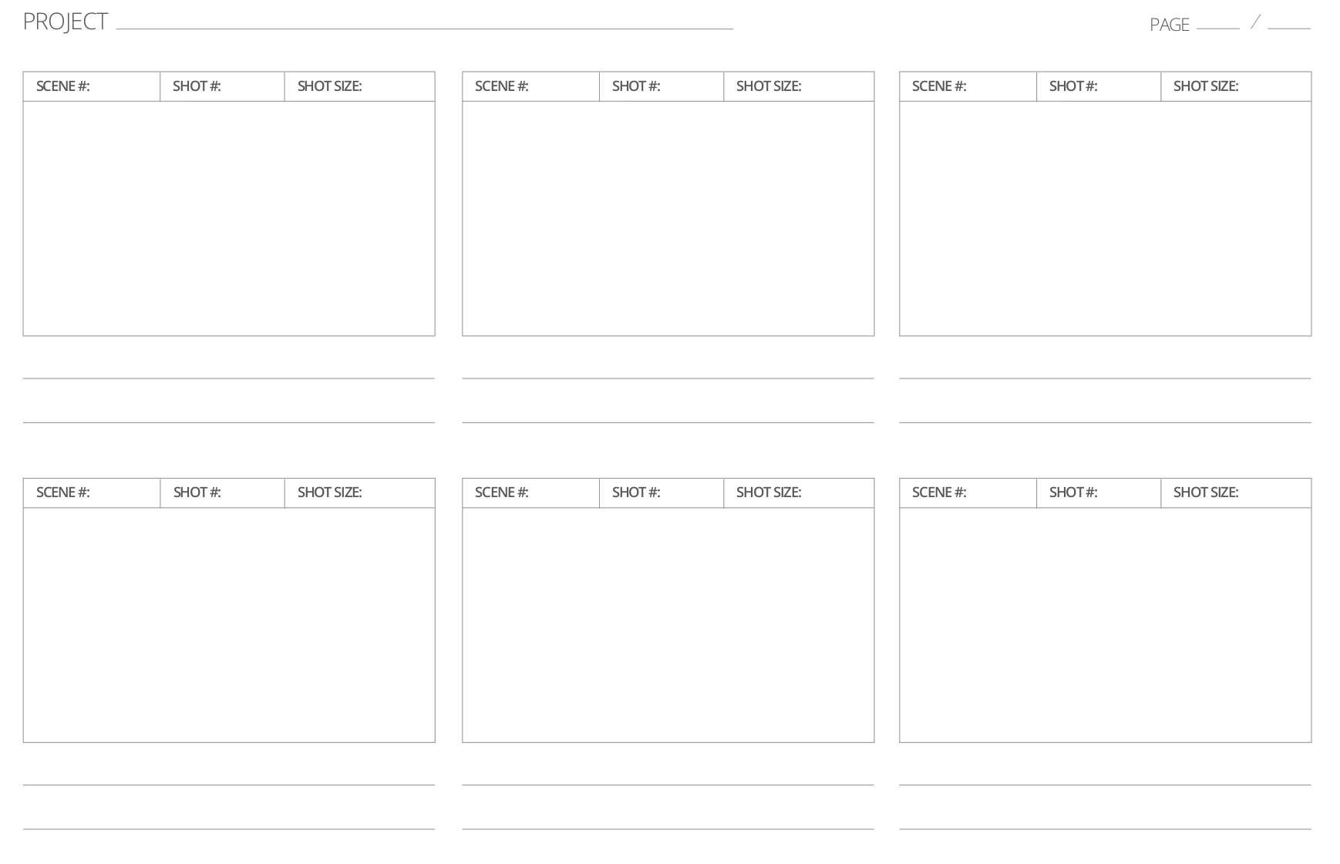
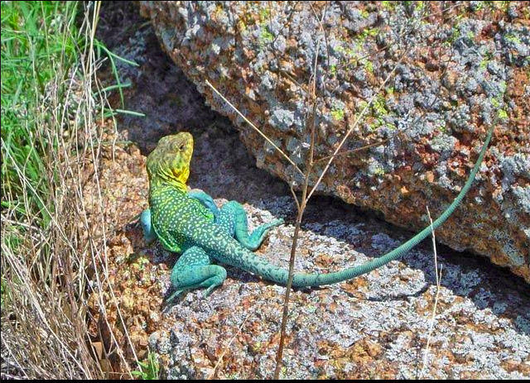
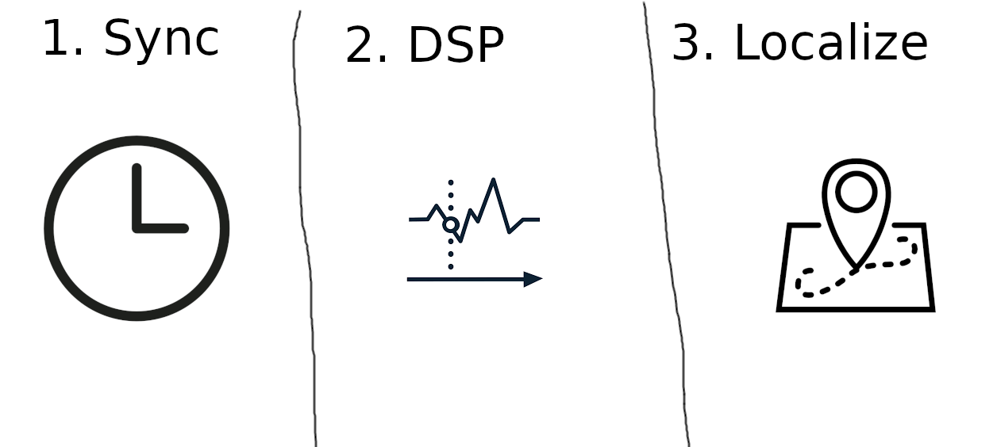
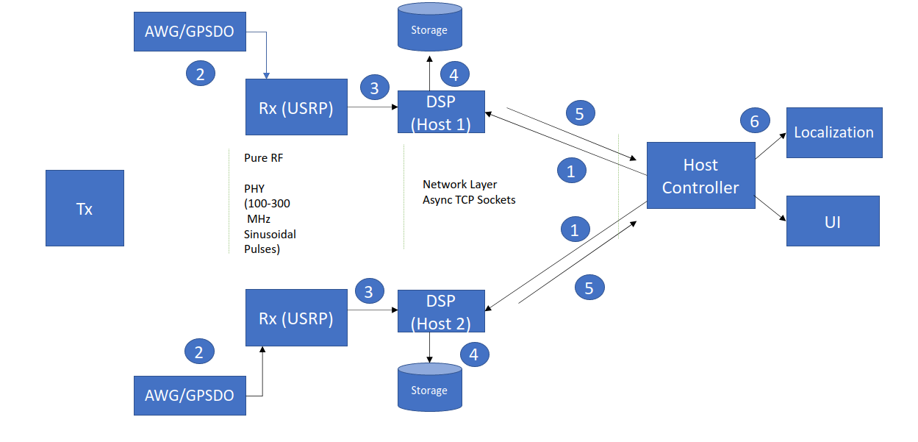
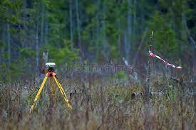
Lizard Localization Receiver Network
1
2
3
Project Motivation: Tracking lizard movements for insight into physiology/environmental responses
Problem Tasks: 1 – Synchronization, 2 – Signal Processing, 3 – Localization
Our Approach for a Proof-of-Concept
4
1
4
2
5
Current Implementation: Block Diagram explanation of our system
Current Implementation: Show the setup we have and demo the network
Future Items: Discuss next steps and additions to improve the system for localization

